Slide 1


Online Voting System using System Generated OTP by Syamchand Chilaka
z

Slide 2
ABSTRACT
z
This will be developed for the risk free and user based web voting system.
The web based voting system will be made for the people of the nation living far and wide and needs to decide in favor of their delegate.
The election will be directed in two different ways the paper polling form election and the mechanized voting form.
The robotized polling form decisions are known as the web based voting.

Slide 3

INTRODUCTION
z
“ONLINE VOTING SYSTEM” is an online voting technique. It is based on the other online services like “ONLINE RESERVATION SYSTEM”.
In this system people who have citizenship of INDIA and whose age is above 18 years of any gender will be cast their vote online without going to any polling booth.
There will be a DATABASE which will be maintained by the ELECTION COMMISION OF INDIA in which all the names of voter with complete information is stored.
This system will help all the people of our country to give their vote online. Using this system will increase the voting percentage across the nation.

Slide 4

SRS(Software, Algorithm, Techniques and Hardware Requirement Specification)
z
Software:
Platform : Windows/Linux
Language Used : JAVA
Database : MY SQL
Designer tool : HTML
Server : Apache Tomcat 9.0.33
Algorithm:
RSA: This algorithm generates a key, encrypts the file and then the key generated is used to decrypt it back to the original form.
MD5: Message Digest 5 (MD5) is a cryptographic function that accepts input of any random length and produces a message digest of 128-bit length which is known as the hash.

Slide 5
3. Techniques: Each voter is provided with unique username and password manually by the administrator. The voter uses the username and password for login and exercise the fundamental right of voting. if incorrect username and password entered, the access to is denied to the user. Also, OTP plays a crucial role in user authentication. Without OTP validation, no access would be granted to the user for voting. And also voter is allowed to vote only once. This is the security feature provided against external access of the system. After login with the correct credentials and OTP, the voter enters the voter home page and casts his vote. 4. Hardware: System : Normal PC Processor : Pentium IV Speed : 2.0 GHz RAM : 4 GB ROM : 500 GB

Slide 6
PROBLEM WITH EXISTING VOTING REGISTRATION SYSTEM
The problems of the existing manual system of voting include among others the following:
1.Expensive and Time consuming.
2.Too much paper work.
3.Errors during data entry.
4.Loss of registration forms.
5.Forgery in voting results.
6.Short time provided to view the voter register

Slide 7
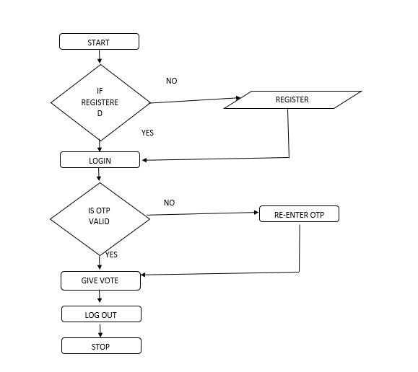
Detailed design of Proposed System
Level - 1

Slide 8
Level-2
List Candidates
Candidate
Vote
Election Details
View Results
Result

Slide 9
Level-2
List Candidates
Candidate
Vote
Election Details
View Results
Result

Slide 10
Pros
Fast and easy service.
The online voting system provides a less time consuming .
It reduces the paper work and makes the work less tedious for “ELECTION COMMISION”.
It is a better way for voting.
By this voting percentage will increase drastically.
Voter has no need to go to any polling booth ,so it is easy to use.

Slide 11
Cons
Difficulty in report generating.
Problems with access to the Internet through the digital divide based on socio-economic variables and between rural and urban areas.
Not everyone is comfortable with the online platforms. So the one’s vulnerable to online world may not be able to use this system.

Slide 12
CONCLUSION
By doing this we will be able to bring a new system for online national voting for our country. With the advent of technology and Internet in our day to day life, we will be able to offer advanced voting system to voters both in the country and outside through our Online voting system.

Slide 13

Thank you
z

